Slide 1
Campus Tour
Team C - Crazy Coders

Slide 2
Project Overview
A campus tour app which is interactive and dynamic, gives audio heads up and scans QR codes on building and retrieve details, tracks the user’s path on a map, shows the un-visited places in campus and shows the updated list of ongoing events on campus

Slide 3
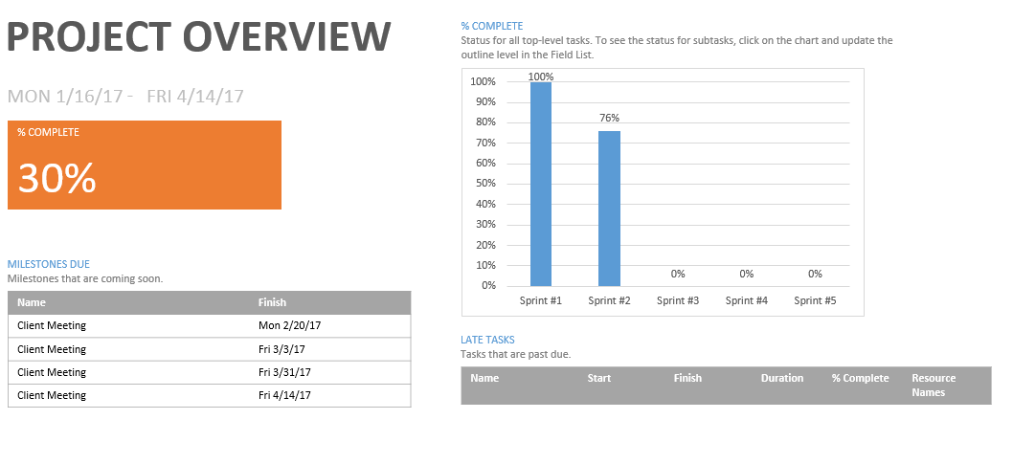

Slide 4
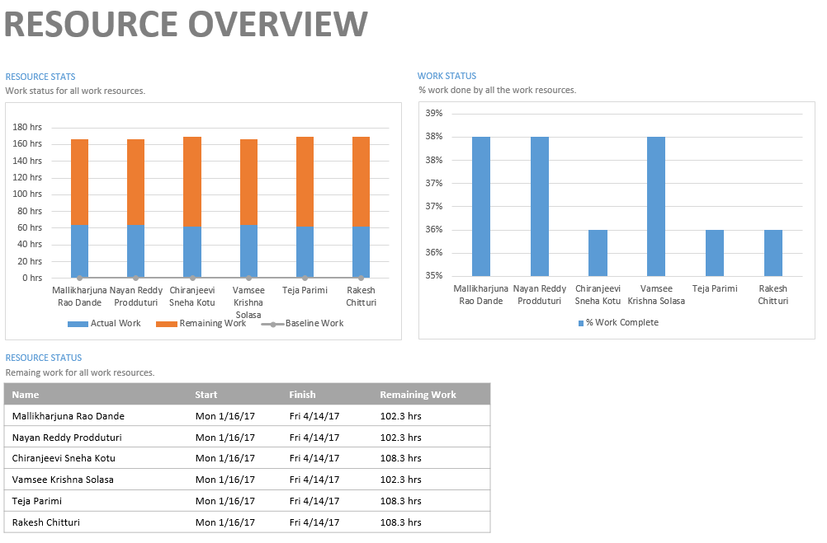

Slide 5
Where are we in the project
At present we completed the second sprint and started the third sprint
So far we have completed the virtual tour in our application and started working on the campus tour
We have started working on the web service and have successfully completed pages where we can add and delete the buildings list
We are doing unit testing for each part of the application
We have to start integrating the project and will do regression test and acceptance test in final sprint

Slide 6
Challenges we are currently facing
The main challenge in our application is to find and get the API for maps. We used google API for about 3 weeks and then we found out the privacy policy that No navigation. You will not use the Service or Content for or in connection with (a) real-time navigation or route guidance; or (b) automatic or autonomous vehicle control
The challenge we faced was to install MySQL and get it to work with java servlet and the webserver calls from the application
Download management for images and videos

Slide 7
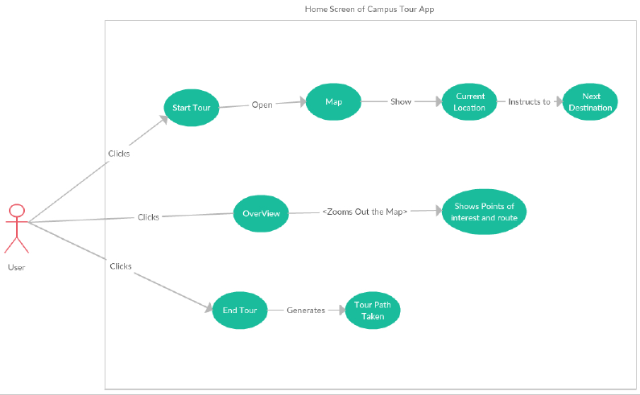
use cases

Slide 8
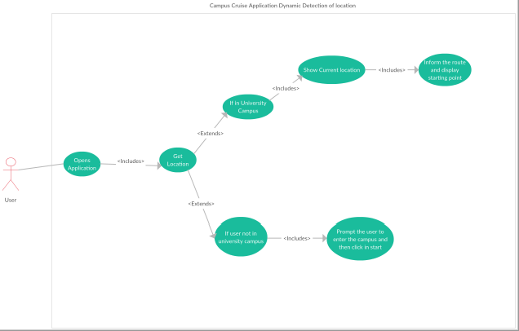
use cases

Slide 9
Software components
Android studio
Netbeans
MySQL

Slide 10
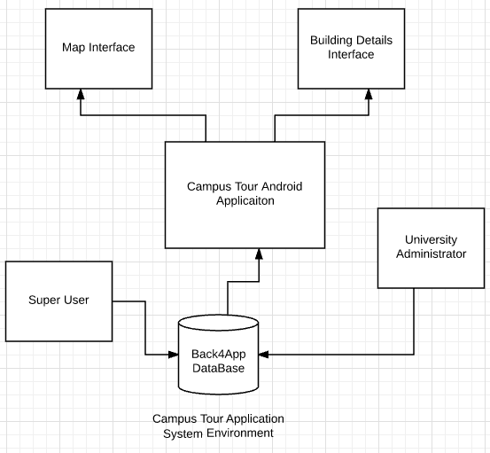
Software Architecture
MySQL Database

Slide 11
Estimated completion time
So far we have about 1500 lines of code and we will be writing about 2000 lines of code in the coming sprint
We plan to deliver the code to the client by the end of fourth sprint i.e. By April 2nd week
We plan to be ready with the final set of project components in about 7 weeks from now

Slide 12
CODE
DEMO

Slide 13
Thank YOU

